Slide 1
Health care ANALYSIS
SriRanjani.B

Slide 2
Healthcare industry
Clinical data plays a vital role in the financial dealings of healthcare businesses today
Data Science helps in advancing healthcare facilities and processes. It helps boost productivity in diagnosis and treatment and enhance the workflow of healthcare systems

Slide 3
task is to analyze clinical and financial data of patients hospitalized
By using python programming language the given problem has been solved
Libraries used in this project are NumPy, Pandas and Matplotlib, RidgeClassifier,RandomForestClassifier, accuracy_score.
Step1: Reading all csv file .
Step2: Perform Exploratory Data Analysis
Step3: Data Cleaning
Step4: Data Visualisation using Matplotlib.
Step5:Data Modeling

Slide 4
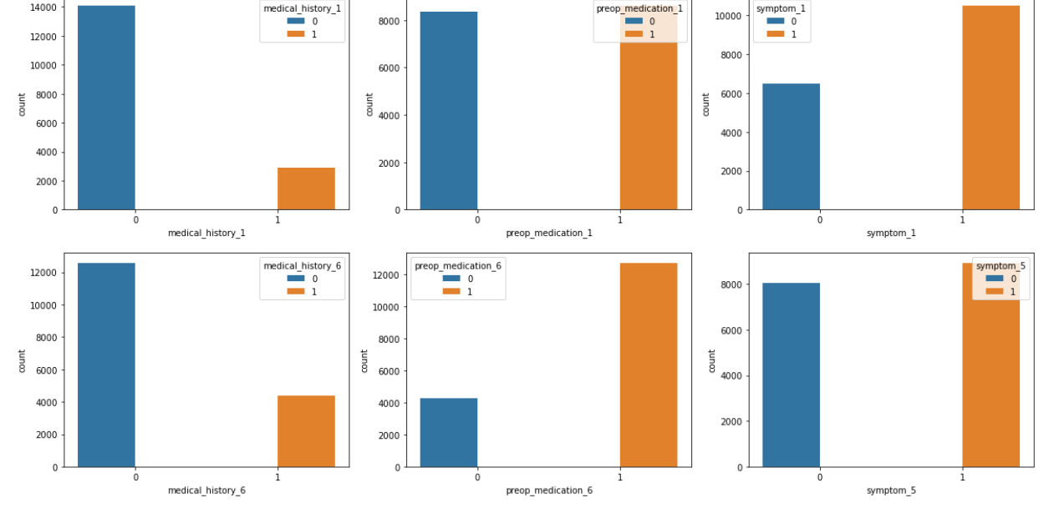
Plotting Binary Feature | Variables :
Features with only two Values (Labels | Classes)with yes or no i.e 0 or 1

Slide 5
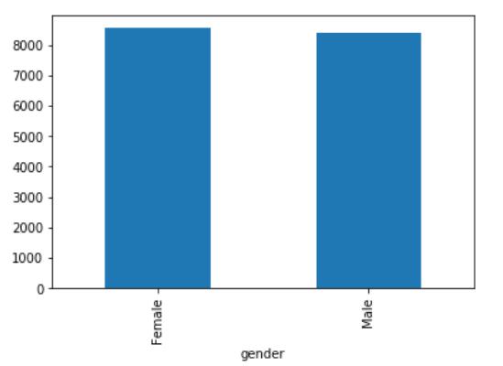
Plotting categorical variables
The quantity of patients in gender(i.e male and female) are maintaing equal count who have been hospitalised for certain condition.
graph explains female has higher number of patient as compared to male.

Slide 6
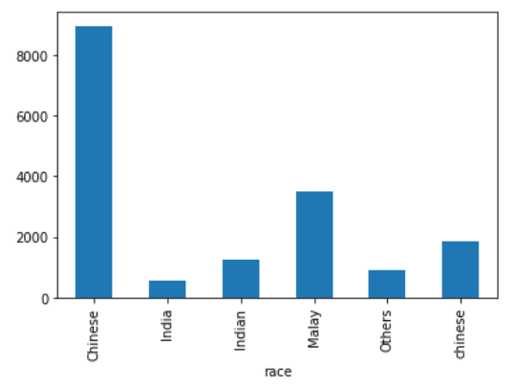
graph between race V/S patient Id
Chinese and Malaysian people are highly hospitalised due to certain diseases. comparing to other countries

Slide 7
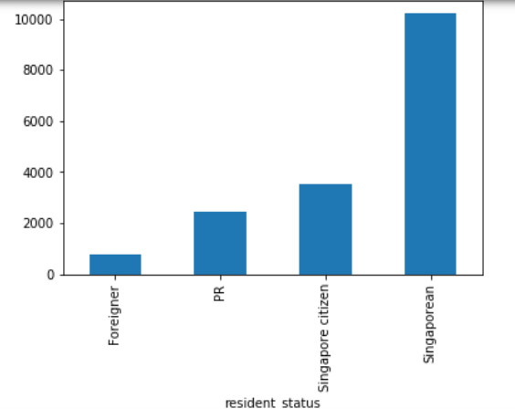
graph between Resident Status V/S Patient Id
Here bar chart illustrates which locality of people residence in Singapore gets hospitalised.
Singapore has highest number of people admitted in hospital compared to Foreigner and Permanent resident of Singapore.

Slide 8
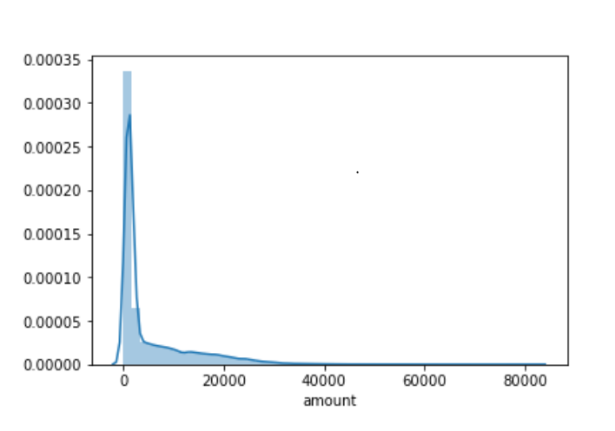
Plotting continuous Variables
plotting continous variables present in our dataframe
Here graph represents the amount variable is positively heavily skewed

Slide 9
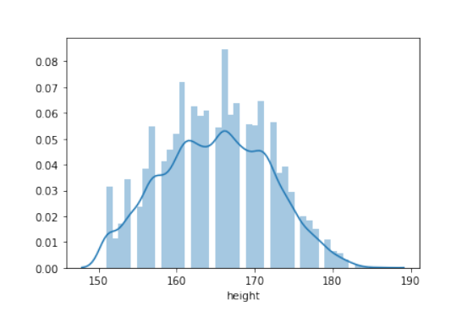
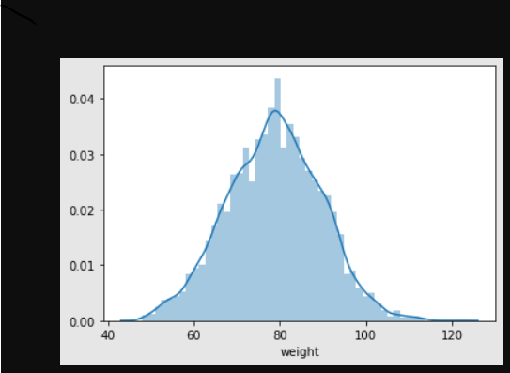
weight variable is moderately negatively skewed
height variable is moderately positively skewed

Slide 10
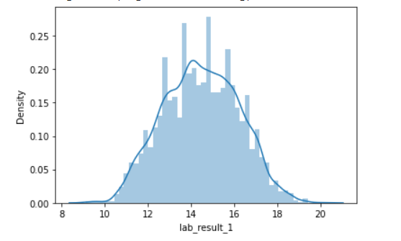
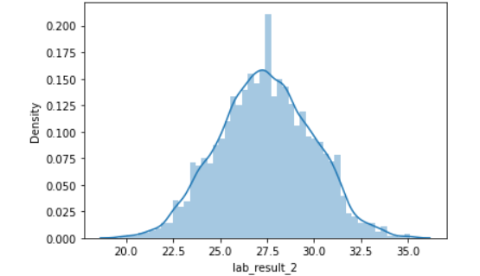
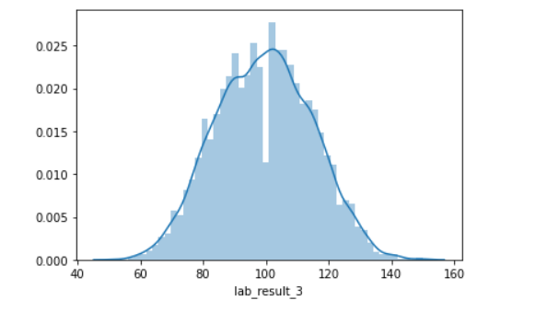
lab_result_1 variable is moderately positively skewed lab_result_2 variable is moderately negatively skewed lab_result_3 variable is moderately positively skewed

Slide 11
Sweetviz
Sweetviz is an open-source Python library that generates beautiful, high-density visualizations for Exploratory Data Analysis
its output is a fully self-contained HTML application.
The system is built around quickly visualizing target values and comparing datasets.

Slide 12
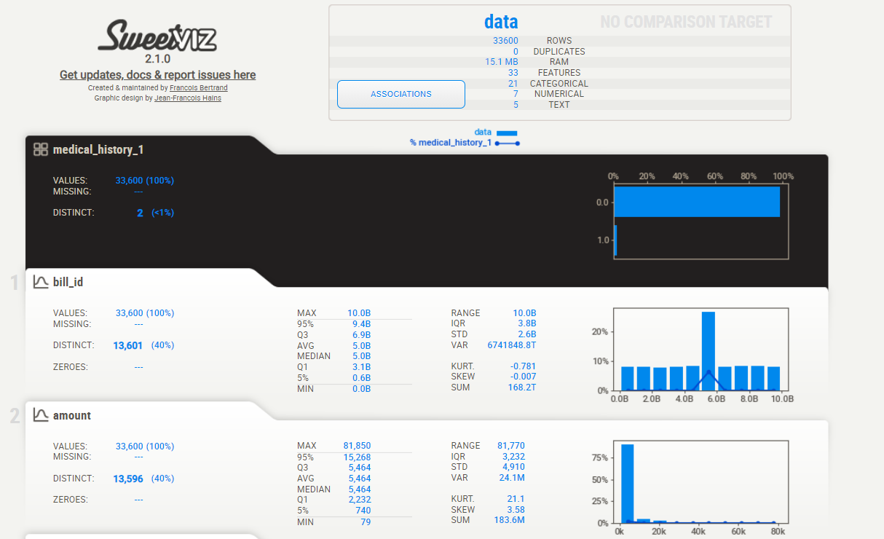

Slide 13
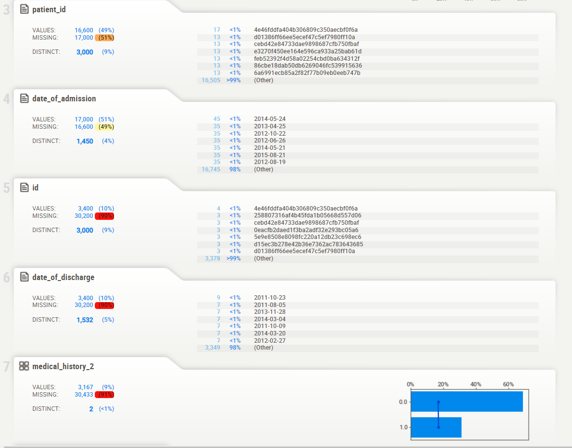

Slide 14
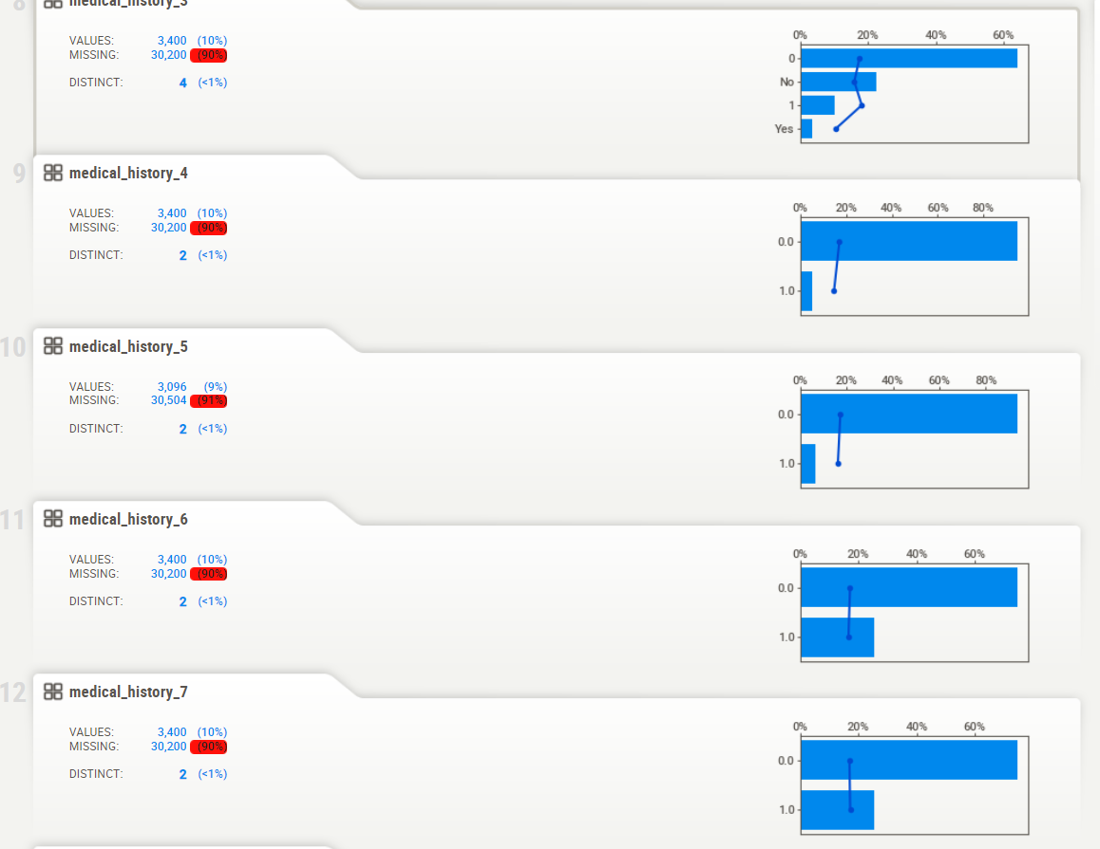

Slide 15
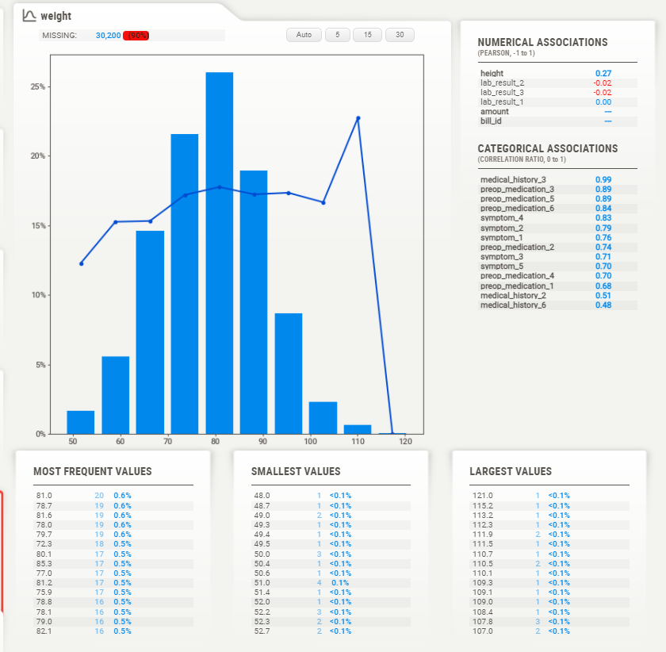

Slide 16
Data Modeling
Ridge Classifier:
Accuracy of Ridge Classifier on Train Set : 82.89%
Model Evaluation:
Accuracy of Ridge Classifier on Test Set : 83.27%

Slide 17
Random Forest Classifier
Accuracy of Random Forest Classifier on Train Set : 83.56%
Accuracy of Random Forest Classifier on Test Set : 83.51%
Accuracy on Training Set is more that Represents Overfitting.
We can Decrease the Depth of the Tree to Prevent Model from Overfitting,
We Must Carefully Optimize the Parameters, Parameter Tuning is Very Critical Part.

Slide 18
We can Increase the Number of Trees which will Help the Model to be more Generalized and Reduce Overfitting.
Another way is to do Cross Validation which Allows to Use Every Sample in Train Set and Test Set.
By using Grid Search Cross Validation

Slide 19
Best Accuracy Score obtained from Grid Search Cross Validation : 84.08%
Grid Search Cross Validation has Improved the Accuracy Score of the Model.
By Checking the Accuracy of Model on the Entire Data Set:
Best Accuracy Score obtained from Grid Search Cross Validation :82.78%

Slide 20
THANK YOU

